Slide 1
First Performance Analysis of MAD-NG Embedded Tracing JIT Compiler
Aurelien Bloch
Supervisor: Laurent Deniau
EPFL supervisor: Martin Odersky
Master thesis, 11 September 2018

Slide 2
Outline
Introduction
LuaJIT
Object Model
Conclusion and future work

Slide 3
Outline
Introduction
LuaJIT
Object Model
Conclusion and future work

Slide 4
Methodical Accelerator Design
Set of tools developed at CERN.
Study, simulate, optimize beam physics for particle accelerators.
MAD-X succeeding MAD-8 in 2002.
Written in C, C++, Fortan77 and Fortran90.
Command-line program that execute its custom scripting language.
Single global workspace.
No function but a simple macro system.
High-level commands customized by the user.
Deferred expressions are heavily used everywhere.
Difficult to improve and maintain.
Tightly coupled module.
Unexpected side effect.
Notes:
MAD or Methodical Accelerator Design is a complete set of tools bundle together and developed at CERN to design, study, simulate and optimize beam physics for particle accelerators. Its current version is called MAD-X. It was first released in 2002 and is the successor of MAD-8. Its source code is mainly written in C, C++, Fortan77 and Fortran90.
It presents itself as a command-line program that reads and execute its custom scripting language. This language has the particularity of having a single workspace where everything is global. There is no function but a simple macro system. Most of the functionalities are provided through high-level commands that can be customized by the user.
Deferred expressions are heavily used everywhere. This code has been internally known to be difficult to maintain and improve. In additions of that, developing new functionality for it takes a significant amount of time due to the fact that module are tightly coupled and modification on its big code base can have unexpected side effect if the developer is not careful. The need for consolidation plus the rise of efficient and modern languages making the development faster and more flexible triggered a new redesign of the MAD application called MAD-NG.

Slide 5
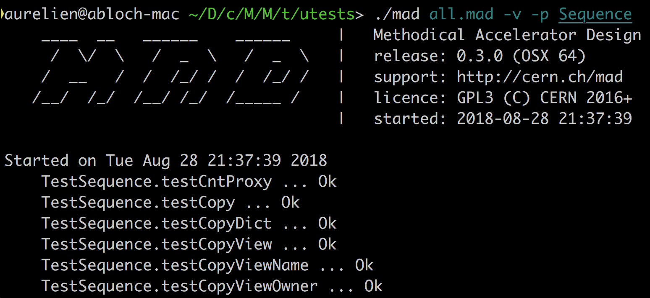
MAD Next Generation
Simple scripting language to offer easier and faster development.
Well-compartmented and modular design for scalability.
At least as performant as MAD-X.
Keep the high level command philosophy.

Slide 6
MAD Next Generation
MAD patch
MAD extensions
Lua equivalent
! single line comment
! number concatenation creates a range
a = 0..-1e6..-1
for _,v in ipairs(1..1e8..0.1) do a = v end
! local ‘in’ table
local sin, cos, tan in math
! lambda syntax
f = \x x*x
f = \x -> x*x
f = \x => a = x * a return a end
-- single line comment
-- number concatenation creates a string
a = 0 .. -1e6 .. -1 – need space
a = range(0,-1e6,-1)
for _,v in ipairs(range(0,-1e6,-1)) do a = v end
-- error prone
local sin, cos, tan = math.sin, math.tan,
math.cos
-- lambda syntax
f = function (x) return x*x end
f = function (x) return x*x end
f = function (x) a = x * a return a end

Slide 7
MAD Next Generation
Module Hierarchy

Slide 8
Lua programming language
Designed by a team at PUC-Rio
Authors claims: powerful, efficient, lightweight, embeddable scripting language.
Supports:
procedural programming,
object-oriented programming,
functional programming,
data-driven programming.
combines :
simple procedural syntax,
powerful data description,
associative arrays,
extensible semantics (Metatable, Metamethods).
Incremental garbage collection.
Dynamically typed.
Interpret bytecodes using a register-based VM.

Slide 9
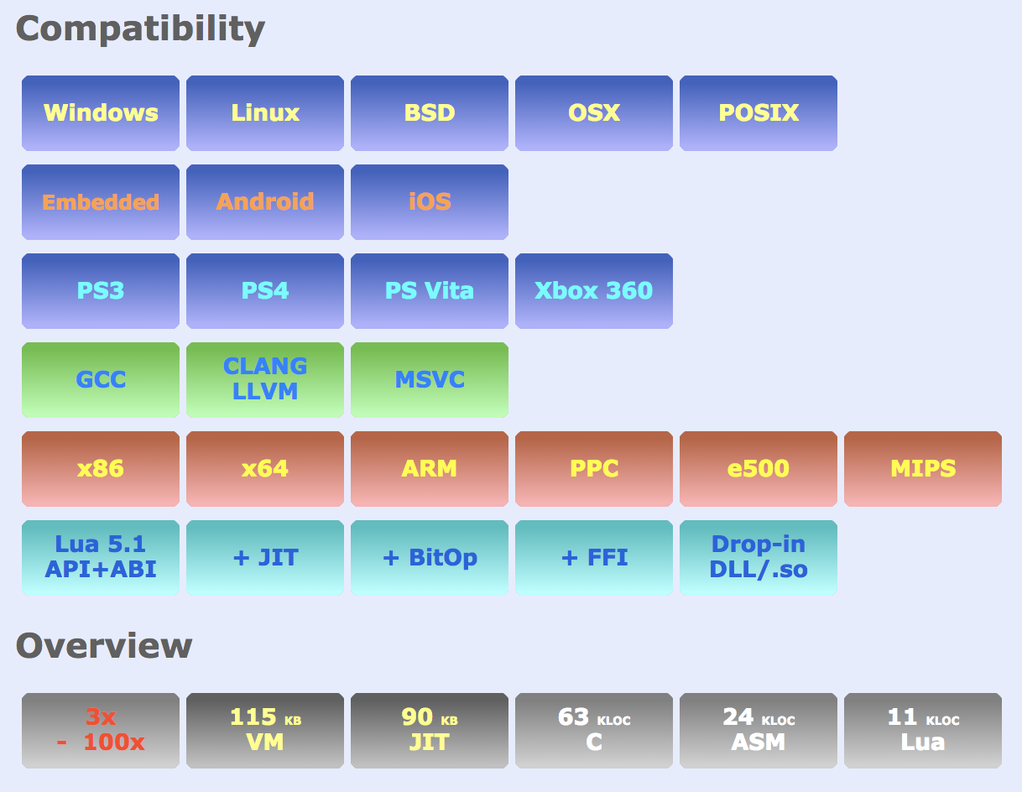
LuaJIT Tracing JIT Compiler
Developed by Mike Pall since 2005
« It's widely considered to be one of the fastest dynamic language implementations. It has outperformed other dynamic languages on many cross-language benchmarks » (LuaJIT website)

Slide 10
Problem description
MAD unit tests.
Significant variance.
Side effect from unrelated code changes
LuaJIT: a one man job.
Lack of documentation (code, mailing list)

Slide 11
Project goals
First performance analysis of MAD-NG.
Study and technical documentation of LuaJIT.
Derive meaningful insight for MAD development.

Slide 12
Outline
Introduction
LuaJIT
Object Model
Conclusion and future work

Slide 13
LuaJIT

Slide 14
LuaJIT
Frontend
BC:
register based,
generated on the fly,
almost no optimization.

Slide 15
LuaJIT
Bytecode interpreter
One file per architecture.
Written with DynASM.
Fast path for fast function.

Slide 16
LuaJIT
Library
Written in C, Lua, ASM
C API.
recorder.
Fallback handler

Slide 17
LuaJIT
FFI .
Conversion:
Lua -> C (Calls).
C -> Lua (returns).
C -> C.
Load external library.
Declaration.

Slide 18
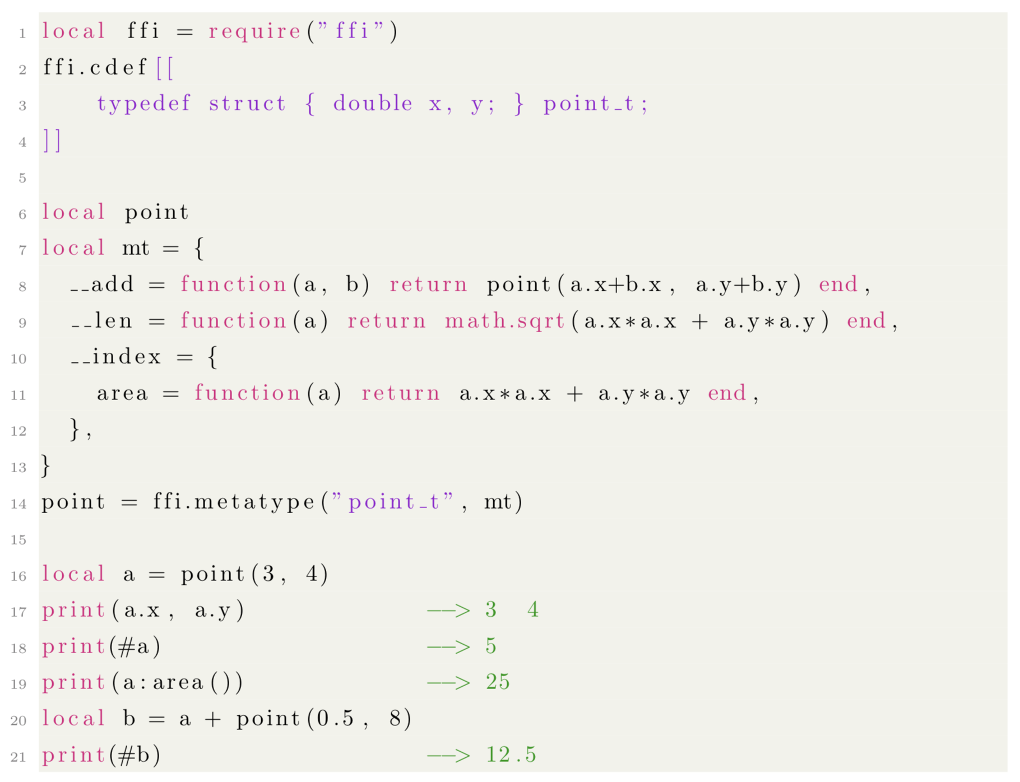
LuaJIT
FFI example 1

Slide 19
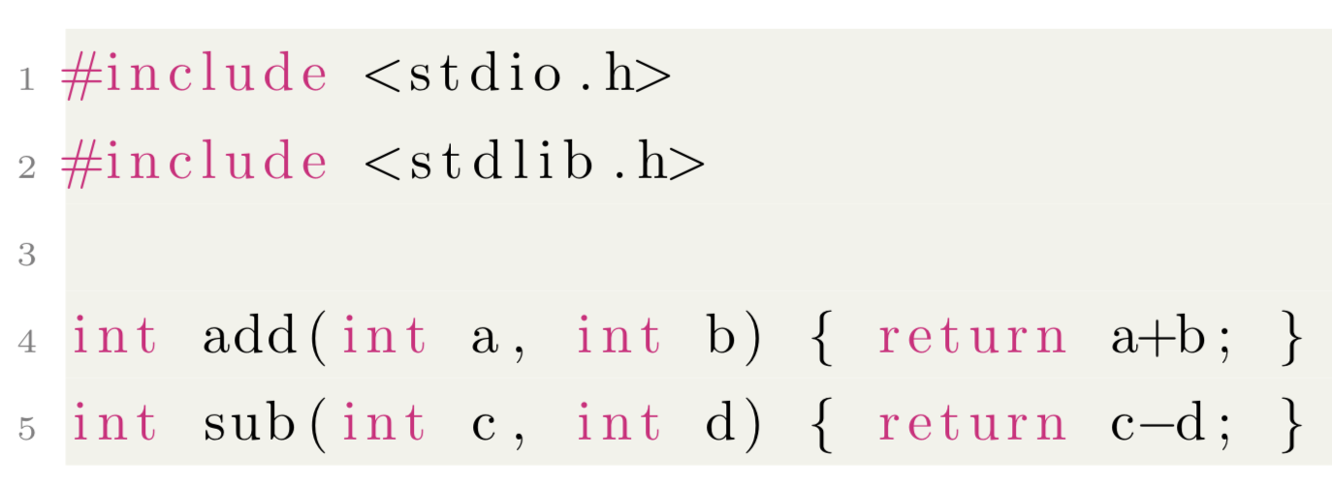
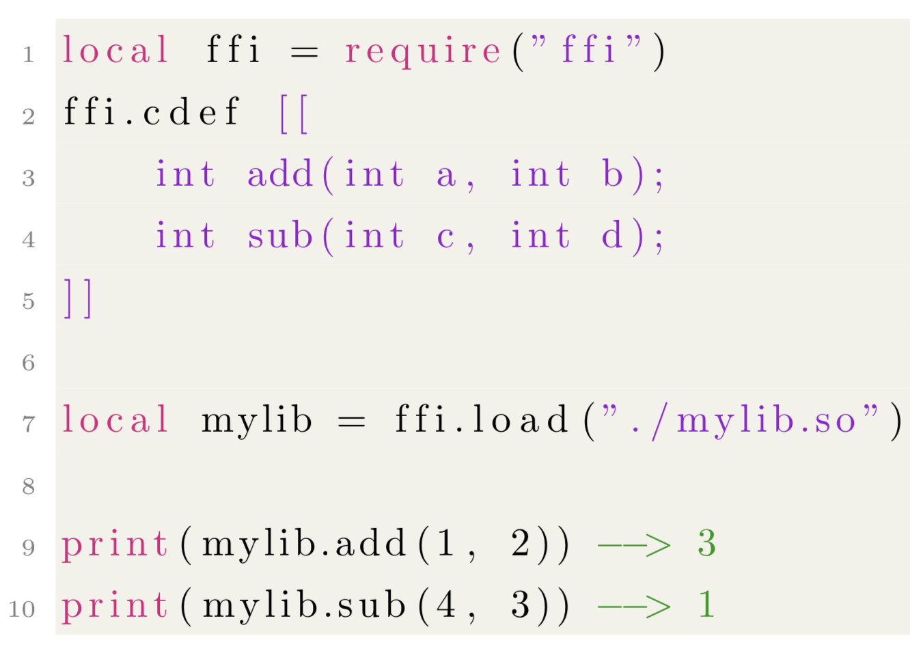
LuaJIT
FFI example 2

Slide 20
LuaJIT
JIT
JIT library for configuration.
Hot path detections:
Loop or Call bytecodes.
profile counter:
low-overhead,
Hashed PC,
64-entries table.

Slide 21
LuaJIT
JIT
JIT compilation is triggered.

Slide 22
LuaJIT
Trace recorder
Remember dynamic data/type.
Generate specialized IR on the fly.
guarded instructions.
flattened control-flow.
assertions on operands.
Abortion and blacklisting

Slide 23
LuaJIT
Trace optimizer
Applied on IR.
Dead code elimination.
Loop optimizations.
Fold optimizations.
etc...

Slide 24
LuaJIT
Trace assembler
Compiled trace.
Not DynASM.

Slide 25
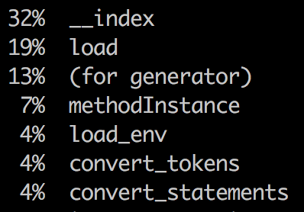
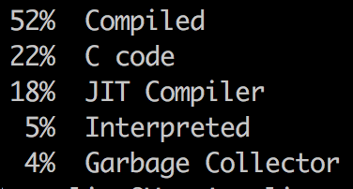
LuaJIT
Tool: profiler
Functions
States

Slide 26
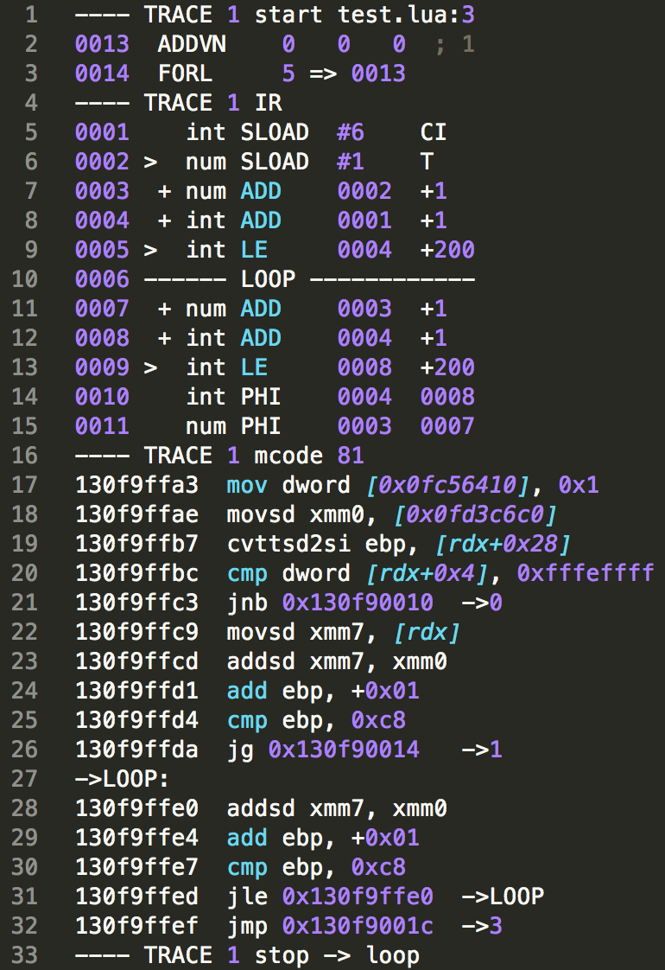
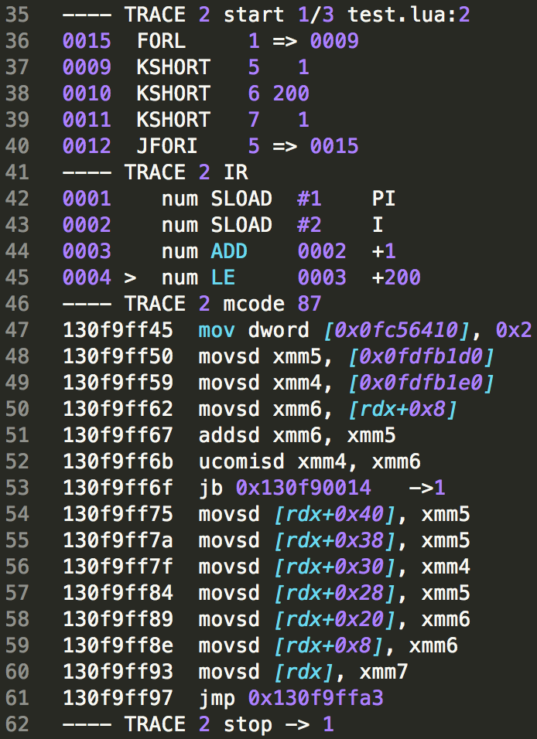
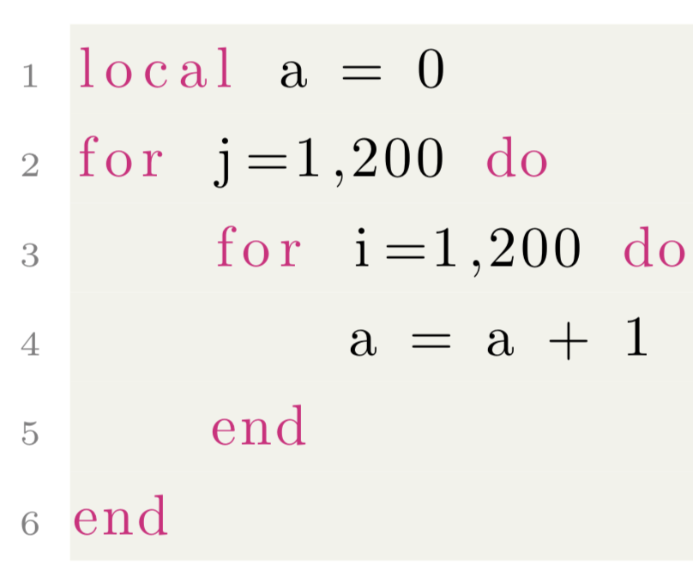
LuaJIT
Tool: dump

Slide 27
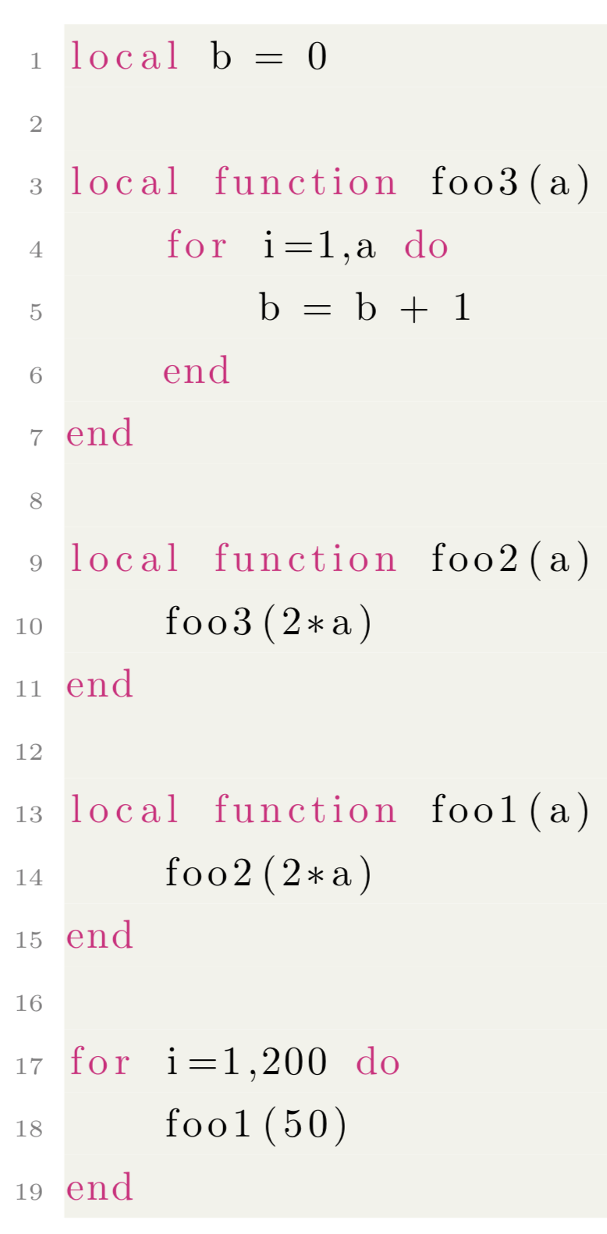
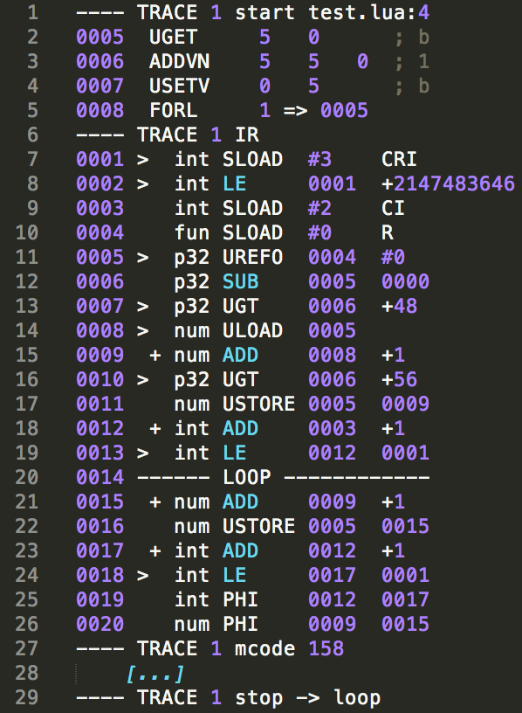
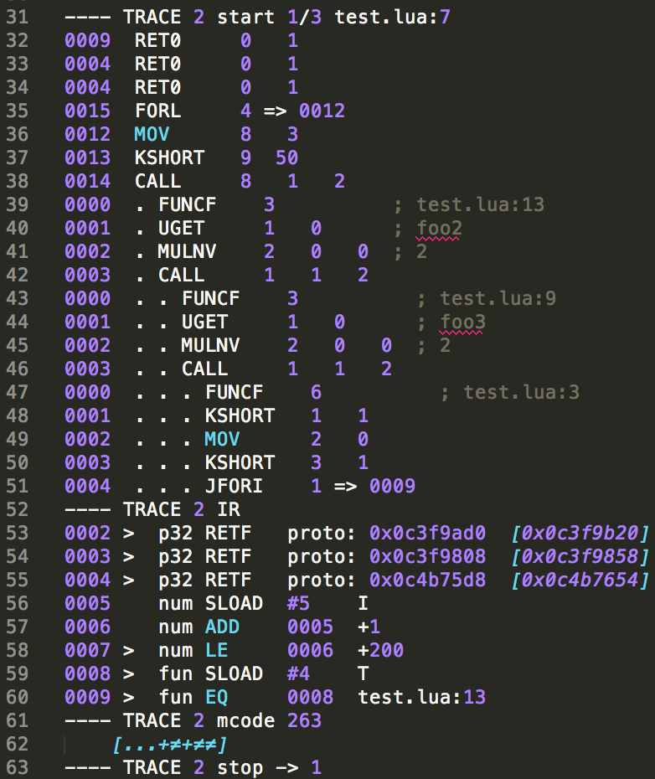
LuaJIT
Tool: dump

Slide 28
Outline
Introduction
LuaJIT
Object Model
Conclusion and future work

Slide 29
Object Model
Instability in the unit tests of the Object Model.

Slide 30
Description
Needs three Lua tables:
Object
var
metatable

Slide 31
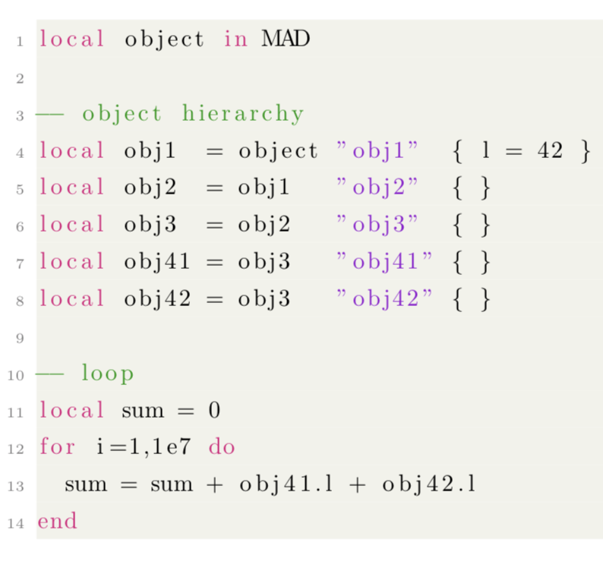
Performance analysis
Example 1
Obj1
l
Obj2
Obj3
Obj41
Obj42

Slide 32
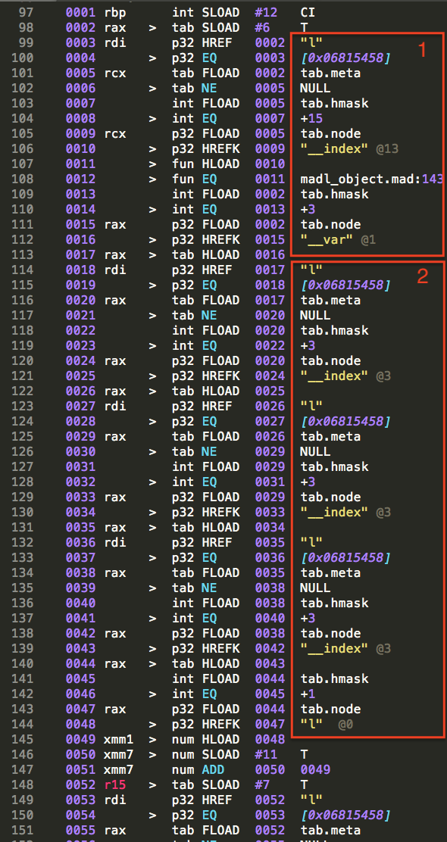
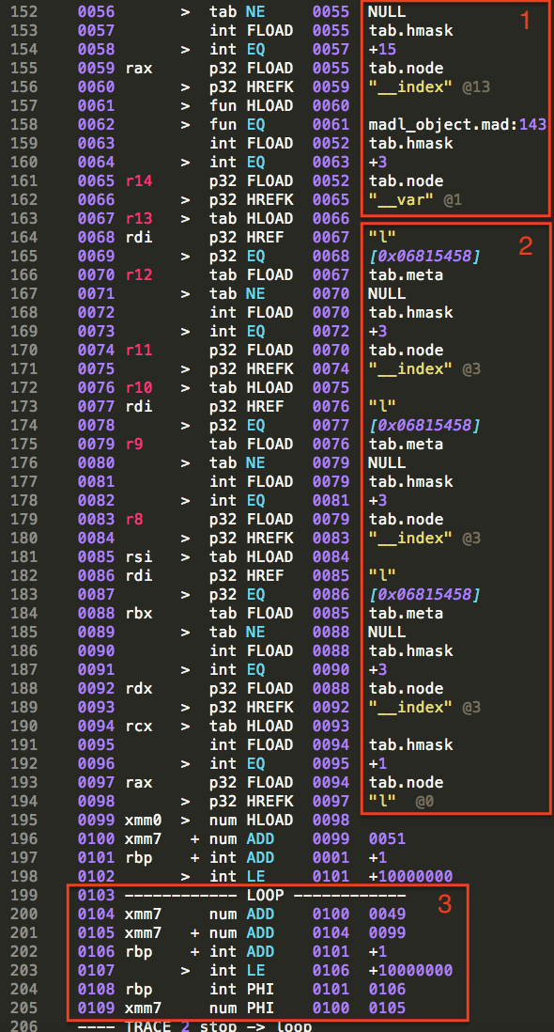
Performance analysis
Example 1
1: First level.
2: Hierarchy chaining.
3: Loop part.

Slide 33
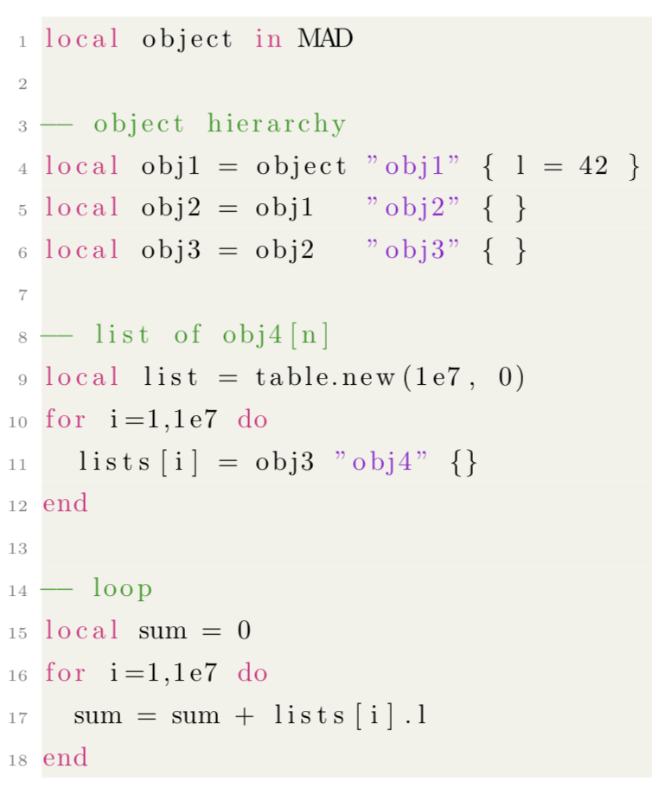
Performance analysis
Example 2
Obj1
l
Obj2
Obj3
List
Obj41
Obj42
Obj4[n]
[...]

Slide 34
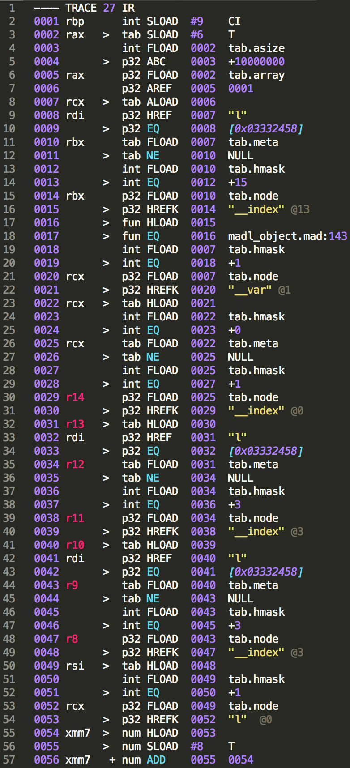
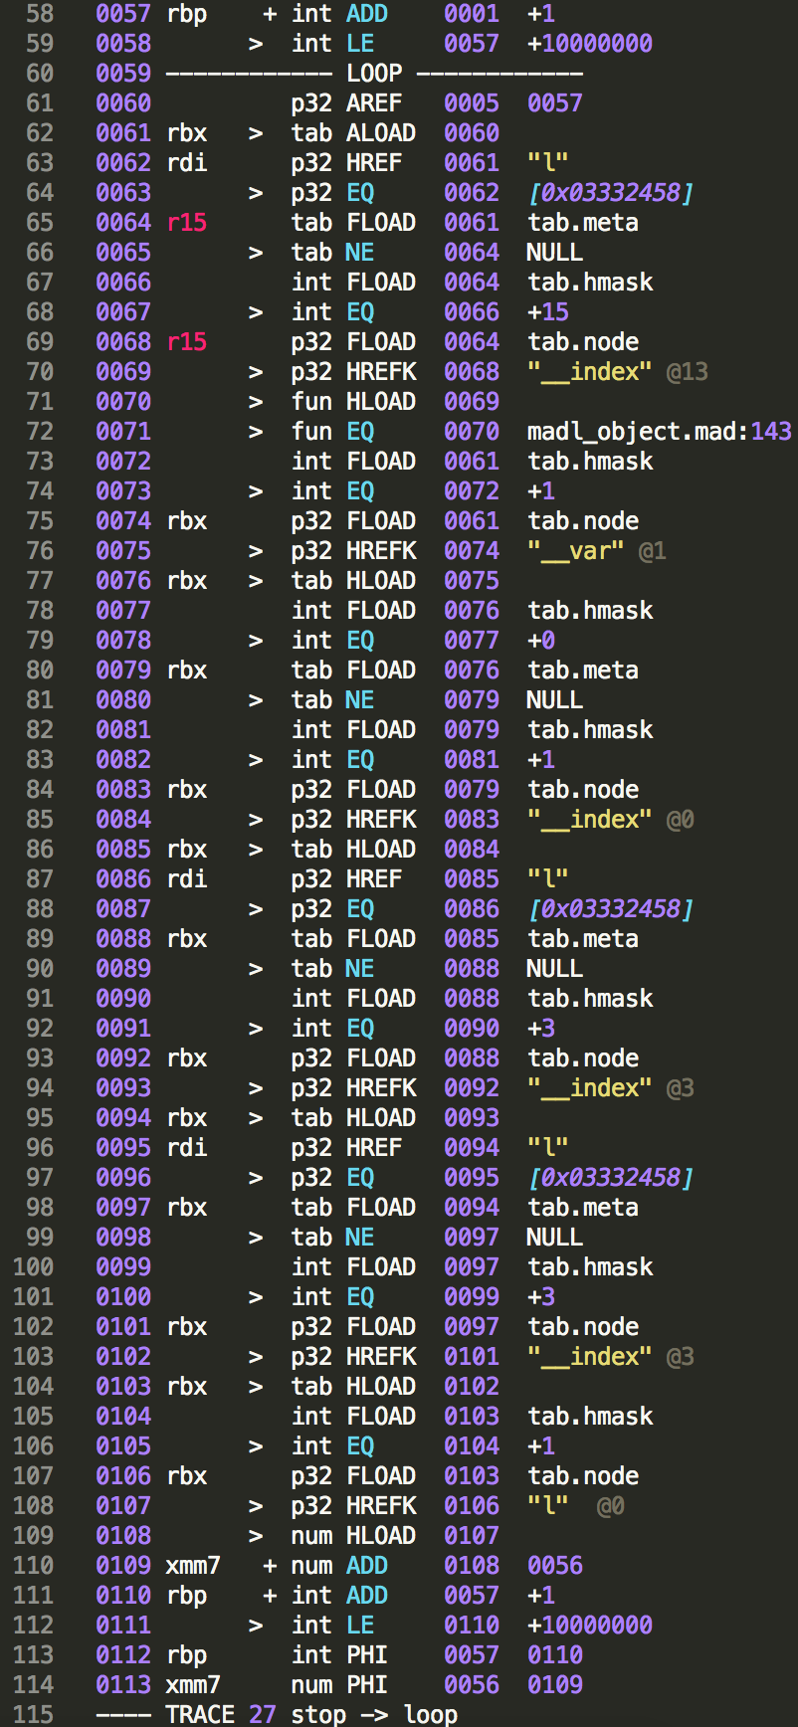
Performance analysis
Example 2

Slide 35
Possible explanations for performance hit
__index function gets blacklisted.
Cascading blacklisting.
Permanant.
Runs entirely in the VM.
Very lazy hot path detections (false positive).
code changes -> changes the bytecode alignment.
Strings are internalized.
Address Space Layout Randomization.
hash-tables placement.
pairs iterator
- Whitelist on flush
- Increase # counters
- detect collisions
- Write pairs-free code

Slide 36
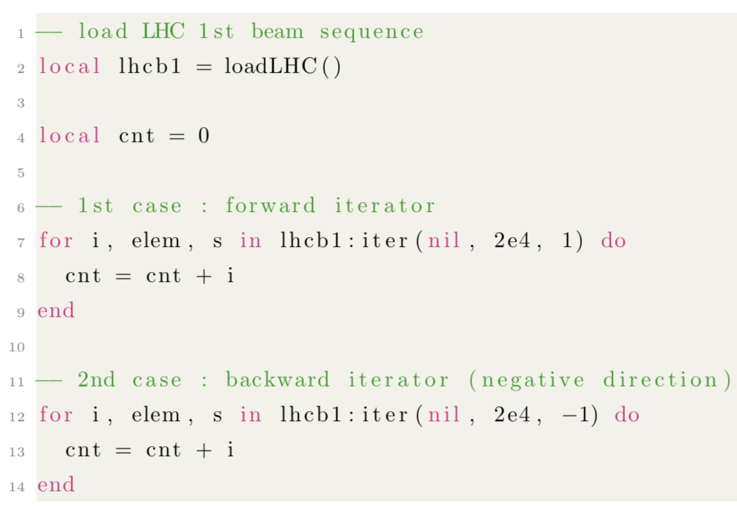
Sequence iterator
TODO

Slide 37
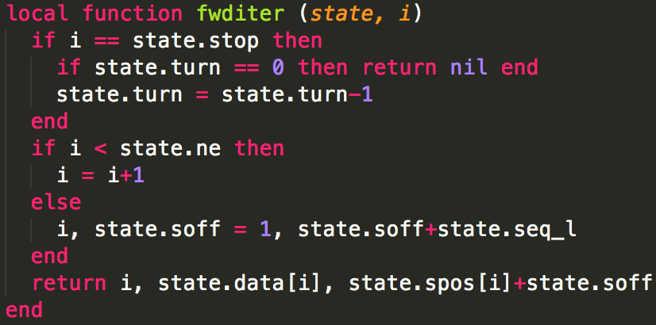
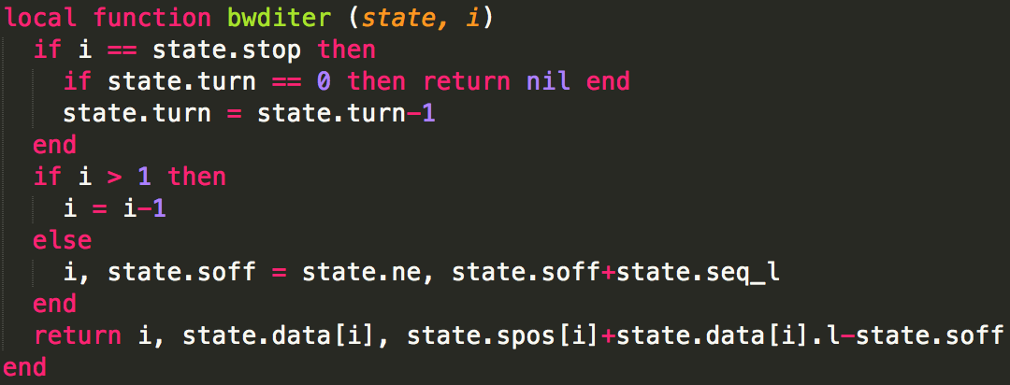
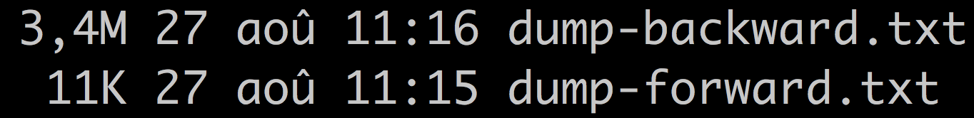
Sequence iterator

Slide 38
Alternative design
Separate variables from methods.
« classe » vs « object »
Calling methods is faster.
Fetching data is slower.

Slide 39
Outline
Introduction
LuaJIT
Object Model
Conclusion and future work

Slide 40
Conclusion and future work
Documentation for LuaJIT beginners.
First performance analysis of MAD.
Through a test case: The Object Model.
Using existing tools.
Better tool for trace analysis.
Needle in a haystack.

